Slide 1
Spiritual Freedom
With Julie Renee
Clear obstacles and blocks to your Best Life
Health, Wealth, Love and Emotional Freedom

Slide 2
Happy 4th of July!
Clearings today:
Money Bring in, sustain and grow money
Success Align your career with your mission
Relationship Freedom, Clearing a bad relationship
Happiness Clearing block to sustaining joy and vitality

Slide 3
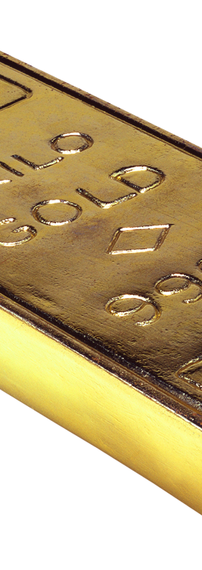
Money
Bring in, sustain and grow money
Amplification clearings
Lucifer stops, soul contracts, demonic, satanic and evil spirit curses
Perception Clearings
Memes, miasms, black magic, curses, atheist, traumas/past life
Emotions
Emotional body and brain
DNA and Bloodline

Slide 4

Success Align your career with your mission
Amplification clearings
Lucifer stops, soul contracts, demonic, satanic and evil spirit curses
Perception Clearings
Memes, miasms, black magic, curses, atheist, traumas/past life
Emotions
Emotional body and brain
DNA and Bloodline

Slide 5
Freedom to Be You!
JulieRenee.com

Slide 6

Relationship Freedom, Clearing a bad relationship
Karma Clearing
Remove:
Energy
Chords
Contracts
Agreements
Karma

Slide 7

Happiness Clearing block to sustaining joy and vitality
Amplification clearings
Lucifer stops, soul contracts, demonic, satanic and evil spirit curses
Perception Clearings
Memes, miasms, black magic, curses, atheist, traumas/past life
Emotions
Emotional body and brain
DNA and Bloodline

