Slide 1
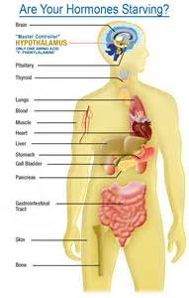
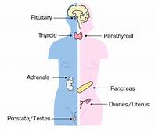
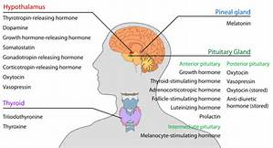

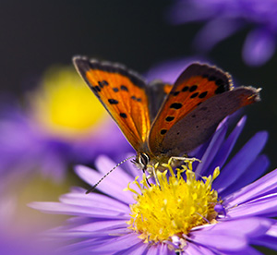
Your Year of Miracles
Endocrine system
JulieRenee.com

Slide 2

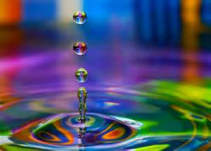

Love wisdom affirmation
I am free to live a life of spiritual freedom and full self expression liberated in love, gratitude and mastery in this body here and now.
My spirit is limitless.
I am responsible for any limits I experience in this body and have complete access to the divine through prayer and contemplation to release myself from any human bonds I have worn as spiritual clothing that no longer resonate with my essence.
Illumination

Slide 3

Opening Blessing Removal of Obstacles
Vakratunda maha kaya
Kyoti surya samapraba
Ner vig nam kuramay devo
Sarvakyaesho sarvahda
Guru Brahmha Guru Vishnu
Guru Devo Mahe swaraha
Guru Sakshat parad bramha
Tasma shree Guruve namaha
Om Gum Ganapatiya namaha
Dum Durgaiya namaha
Om eim Saraswatiya swaha
Om shanti shanti shantihi

Slide 4

Training One
Brain Clearing
ENDOCRINE SYSTEM REBOOT
There are eleven glands and organs that make up the endocrine system and today we will clear and regenerate all parts.
Especially important are the adrenals and the pineal gland for good sleep.
We address the:
pineal, pituitary, hypothalamus, thyroid, parathyroid, thymus, heart, stomach, pancreas, adrenals, liver, ovaries and testicles.
It’s a whole heck of a lot to clear and regenerate so we’ll be moving rapidly through the processes to get the very best results for you!

Slide 5
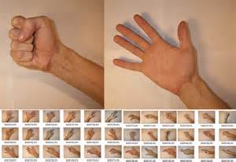
Hand movements to access the quantum field
Standard Quantum pump
Discrete pump for walking or under table
Double pump
Foot pump
DNA Side Slide

Slide 6
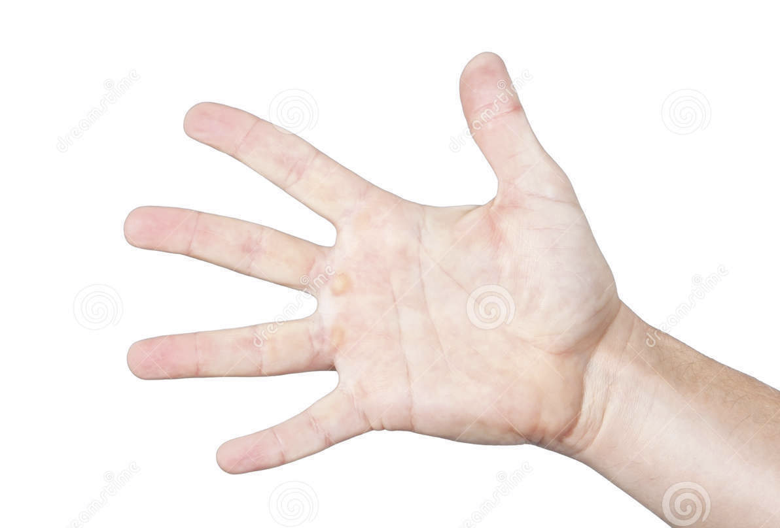
Muscle testing

Slide 7

permission right & ability to have healthy fully functioning endocrine system glands organs and hormones removing suppression domination control:
Areas of the blueprint affected:
Perception 99%
Matter 99%
Energy 9%
Genesis 8%
Embodiment 53%
Amplification 99%
Lucifer stops
Bloodline
Satanic Curses
Group mind virus
Black Magic
Curses
Control energy
Cycles
Agreements
Atheist thought forms
Trauma
Medical control energy
DNA, others, resets
Reptiod (5)
Portals wormholes deception bitterness
MIB (type 7) wormholes
Embedding DNA Splicing unforgiveness disappointed bitterness
Spiders permeations anger
Snakes mechanisms
Resentment unforgiveness deception
Emotional Anchors:
Malice
Hatred
Resentment
Anger
Blame
Unforgiveness
Crushed
sorrow
Bitterness
Disappointment

Slide 8
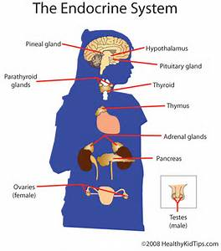

Slide 9
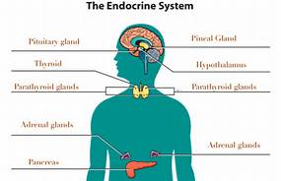
Brain glands
Pineal Hypothalamus and Pituitary

Slide 10
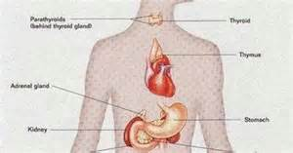
Thyroid, parathyroid, thymus, heart

Slide 11
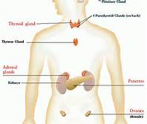
Adrenals, Stomach, Kidneys, Pancreas
Liver

Slide 12
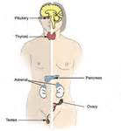
Ovaries,
Testacies

Slide 13

Regeneration
Cellular Neo Genesis
Revitalization of existing stem cells and the genesis of new stem cells.
This technique uses the master cell this is the original stem cell for
the area being regenerated and hold a great deal of information about
how to grow new cells. Using the quantum field and a hand movement
called the ‘quantum pump’ the stem cell is brought to 100%. Cell
regeneration is brought about by activating the perfected master cell
in the human blueprint than moving this cell into physical reality. For
example one might imagine it as the perfected cell is replacing the
old unhealthy cell or the master cell from the blueprint is taking form
where no cell currently exists. Medically document regrowth of a failed
adrenal and new growth of a surgically removed colon.

Slide 14
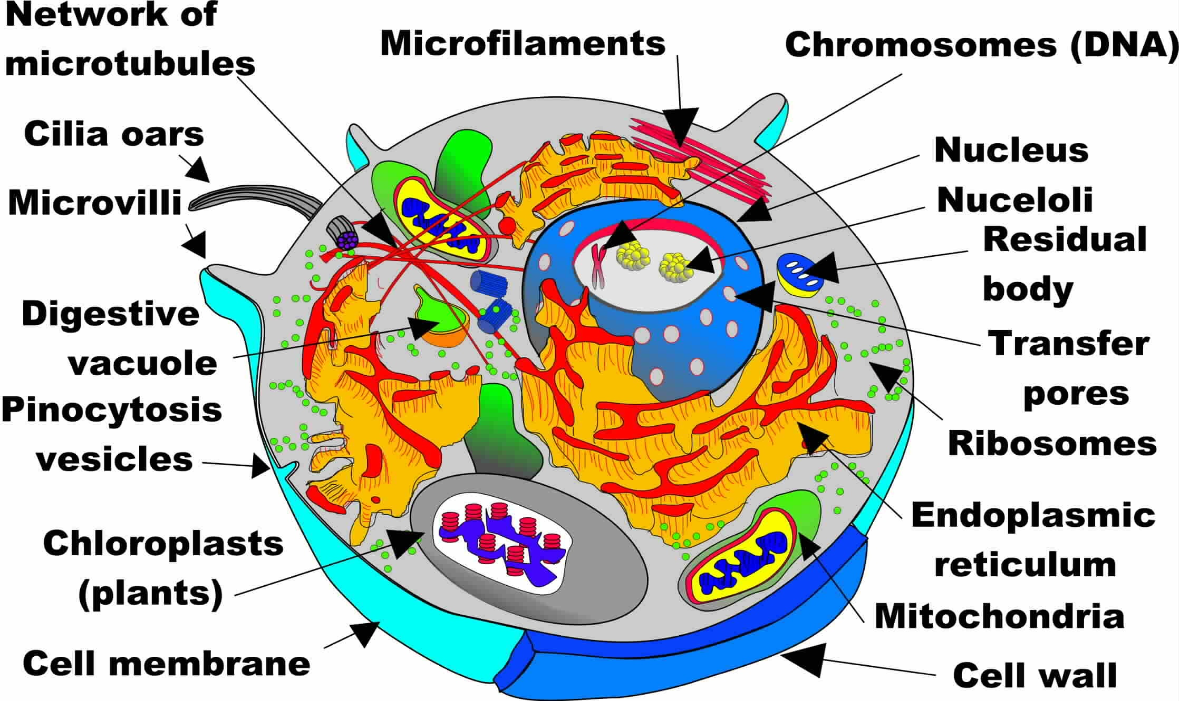

Slide 15
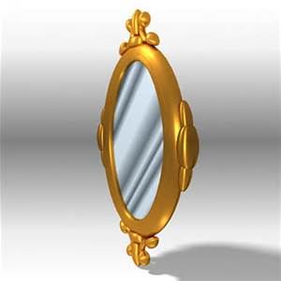
Mirroring to surrounding cells

Slide 16
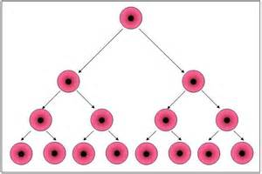
Cascade of new cell growth

Slide 17
In the stillness
In the stillness
In the quiet
In the open heart
There I am
I am essence
I am breath
I am light of God
I am I am

Slide 18
A call to lighten
Soft the night and sweet the spirit,
Gentle voices call our song,
We are magic we are wonder
When we live beyond the veil.
Human kind please raise your thoughts
Bring a plane of peace and love
We the guardians of the pilgrims
We the authors of the play.

Slide 19

Angels Call
Angels call while we are sleeping
Riding through the waves of dreams
Keeping safe our mortal bodies
While we play in astral scenes
Beams of light flow from their bodies
Showing us a glimmering mirror
Waking to the world of wonder
Leaves behind all doubt and fear

Slide 20
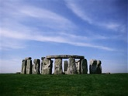
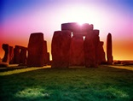
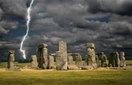
The Stones
The stones they are a calling me
Echoing through an eternity
Calling out to set us free
The power of the stones
At dawn I walked in a circle of stones
A solar temple to me yet unknown
Till by the strength of first mornings light
Shown the power of the Stonehenge stones
They grounded the energy of this place
And held us together in loving embrace
While beings of light danced above the space
Bestowing on us their wisdom and grace
The Avebury stones were laughing at me
Taunting me tempting me dancing with glee
Playful stones make love to me
In the circle of the stones
The heavenly chambers from days of old
New Grange stones were a circle to behold
I knelt in prayerful reverence
For the power of the basin stone
I touched my forehead to the rock
It filled me with bright light and talk
Of the ancient people and their ways
And the spirals of the stones
Stones are everywhere we look
Medicine wheels and monolithic books
The wisdom of the circle flows
In the temple of the stones
2002

Slide 21
Speak Softly Gentle Knight
Speak softly gentle knight
Your kindness to reveal
Hold me in your strong arms
And warm my frozen heart
Tell me of legends old
Of Arthur and his bride
Bring stories back to life
Your gentleness exposed
Speak softly gentle knight
Of honor code and rule
The ways of chivalry
Bring to this century
And when I smile at you
Your eyes alight with mine
Your costume and your ways
Speak true of Gelfad days

Slide 22

Next Steps
Are you a Part of
Our Inner Circle Community?
More to consider!
Quantum Activations Apprentice Online
Diamond Advanced Certification

Slide 23

fall Trainings
Carmel Valley Nov 27 – Dec 3
Space limited
Free
Opening to the light
Apprentice intro
Weekly classes
Understanding anchors and spiritual interferences
Removing trauma and abuse from your field and body
The Sound of truth
How to meditate
Illumination rosary
Divine connection
Special classes
Healthy Hair
November
Year of miracles
Endocrine system
Hormones

