Slide 1
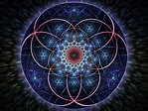
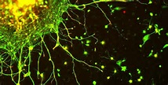


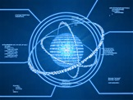

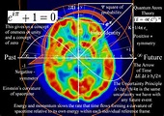

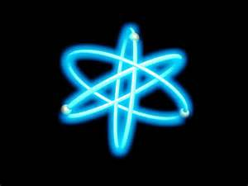
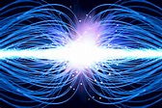
Putting It All Together
5 minute break Quantum Activations
Julie Renee

Slide 2
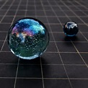

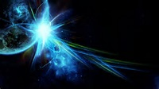
Quantum Activations
The working parts how they integrate together and where all the unique clearings belong

Slide 3

Amplification
Ghosts are either dead or in body but occupying you also
Evil spirits without body
Demons
Transmortals
Aliens
Entities
Satanic or dark energies
Lucifer stops
Soul Contracts
Demonic, evil spirit, satanic curses
Cycles
Timelines
Worm holes transmortals
Mechanism, including embedding aliens
Seeds aliens
Implants aliens
Karma

Slide 4
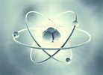
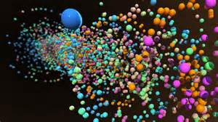
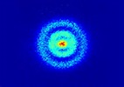

Perception
Group Mind Meme
Group Mind Virus Miasm
Curses
Black Magic
Atheist thought forms
* Trauma from past
lives and also this life
Etheric body - emotional body
Cycles
Timelines

Slide 5
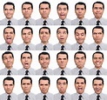
Emotions
Emotional thought forms
Emotional Body
Etheric Body
Emotional Brain
(in meditation clearing center of head)
Heart
Pancreas
Ovaries
Shared energy
Cords
Contracts
Agreements
Karma
Cycles
Timelines
Ghosts

Slide 6
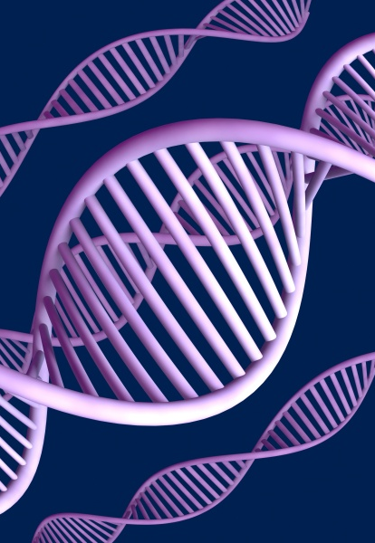
DNA/Bloodline
DNA
DNA Repair
DNA Reset
Telomere Expansion
DNA from transplant or transfusion (assert clearing all DNA)
Bloodline (Clan)

Slide 7
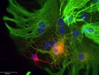
Cellular Neo Genesis
Intend the master cell
Pump quantum pump to stimulate the blueprint
Get cell to 100% in all aspects…organelles DNA and broken DNA, membrane and nucleus
Activate light of cell for mirroring
Mitochondria for cascade of new cell growth
Identify days of new cell growth and if an additional regeneration would be beneficial

Slide 8
Ask questions Please don’t worry about being perfect
I believe in you and your capacity to heal, grow and learn, this is your time to shine!

Slide 9
Identify
Clear just removes problem energy
Rejuvenate
Regenerate
Rest
Nourish or Sustain ~ Finding Balance
Inner and outer actions for a full clearing and rejuvenation

Slide 10

Meditation Envisioning ease as your Master the Quantum Activation techniques

