Slide 1
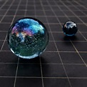


Freedom from Spiritual Parasites and Pests Quantum Activations
With Julie Renee

Slide 2
Om tyrumbicum ye jama hay
Sugundem push ti vardinam
Urvar rucumivat bandanot
myrtyour muksheeah
mom ree ta to

Slide 3

Demo
Quantum pump technique for clearing and
What is quantum and how does it work?

Slide 4
Migraines and headaches ~ demons, aliens, guides
Restless leg ~ demons, evil spirits, guides
Sleep issues ~ aliens, guests, guides, trans mortals
Slave issues ~ entities, aliens, ghosts, evil spirits
Digestion occupation ~ entities, guests, ghosts
Nerve issues ~ aliens, demons, mechanisms, imbedding, transplants
Vision ~ guests
Obsessive compulsive. Looping thoughts ruminating ~ guests, guides
Addictions & self sabotage ~ entities, aliens
Skin problems ~ entities, guides
Procrastination disorganization~ lack of motivation ~ ghosts, entities, aliens
Toxins and memory issues ~ entities, aliens, seeds, implants
Vomiting ~ entitles, guides, demons
Ear issue hearing blocks and tinnitus ~ Aliens, implants, seeds mechanisms, ghosts
Exhaustion & fatigue ~ ghosts, evil spirits, entities
Parasitical infections stimulate & Fungus ~ aliens, implants, mechanisms
Bones pain & Body pain Aliens, seeds, implants, demons, transmortals
Low level of organ function ~ aliens, entities
Blood disorder ~ entities
Sudden memory loss ~ aliens, embedding, ghosts, evil spirit
Breathless ~ transmortals, wormholes
Racing heart ~ demons. Aliens, seeds
Personality changes ~evil spirit, guest, guide, walk in, ghost
mental illness behavior ~ Evil spirit,
chaotic behavior ~ alien
anger irritation ~ demon

Slide 5
Perception, Essence, Matter, Energy
Perception
Aliens
Spirit Guides
Essence
Embedding
Implants
Seeds
Mechanisms
Wormholes
Matter
Ghosts
Spirits
Evil spirits
Demons
Walk-ins
Energy
Entities
Transmortals
Wormholes
portals

Slide 6

Amplification
Lucifer stops
Soul Contracts
Demonic, evil spirit, satanic curses
* Cycles
Timelines
Karma

Slide 7

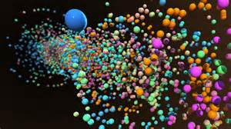
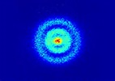
Perception
Group Mind Meme
Group Mind Virus Miasm
Curses
Black Magic
Atheist thought forms
Timelines

Slide 8
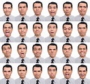
Emotions
Emotional Body
Emotional Brain
Cords
Timelines

Slide 9

DNA/Bloodline
DNA
DNA Reset
Bloodline (Clan)

Slide 10
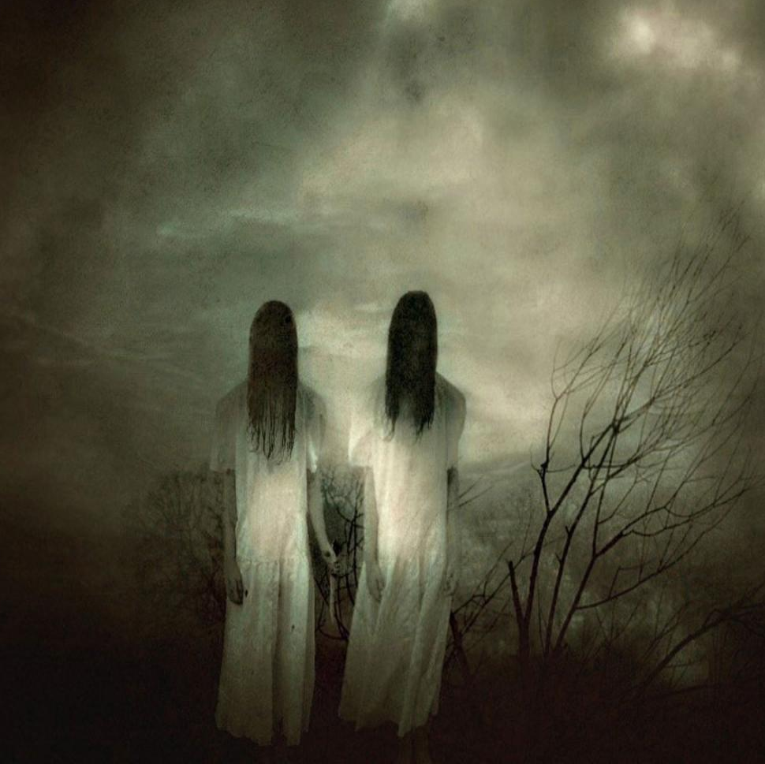
Freedom from Spiritual Parasites and Pests
Satanic or dark energies

Slide 11
In the Stillness
In the stillness
In the quiet
In the open heart
There I am
I am essence
I am breath
I am light of God
I am I am
2003

Slide 12
Chant to Lakshmi
To the goddess of beauty grace love and wealth
Be my guide in dark times
Be my guide in light times
Be my light in dark times
Be my light in light times
Be my love in dark times
Be my love in light times
Be my hope in dark times
Be my hope in light times
Be my help in dark times
Be my help in light times
Be my wealth in dark times
Be my wealth in light times 2009

Slide 13
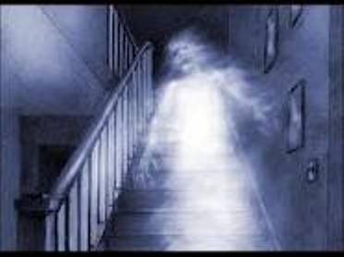
Freedom From Spiritual Parasites and Pest
Removal of Ghosts are either dead or in body but occupying you

Slide 14
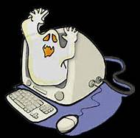
Clearing technology
Ground the technology
Muscle test ~ aliens ~ demons ~ transmortals ~ entities
Lasso technique
Chopping hand movement

Slide 15
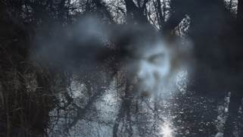
Freedom From Spiritual Parasites and Pest
Evil spirits without body
Friendly spirits

Slide 16
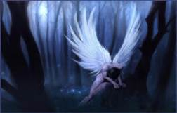
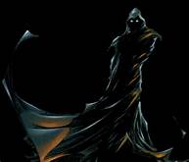
Freedom From Spiritual Parasites and Pest
Demons
Risen Demons ~ live off life force
Fallen angels

Slide 17
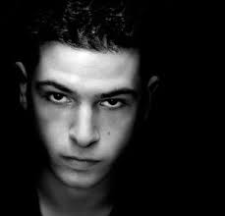
Freedom From Spiritual Parasites and Pest
Transmortals
Wormholes
cords
embedding

Slide 18
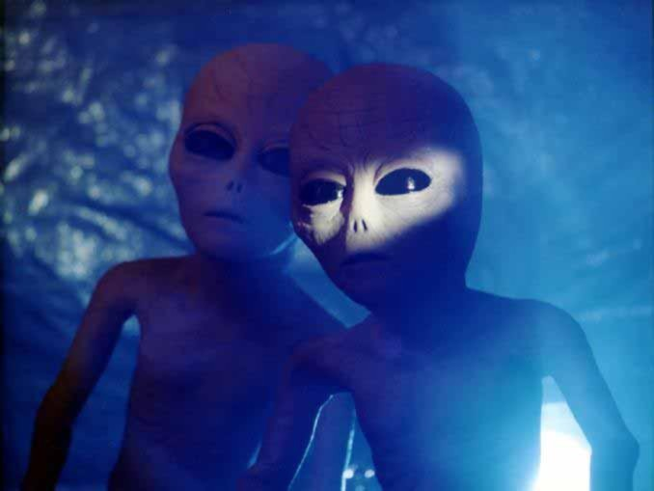
Freedom From Spiritual Parasites and Pest
Disruptive Aliens and all aliens in your essence,
field and body
Mechanism
Embedding
Seeds
Implants

Slide 19
The Stones
The stones they are a calling me
Echoing through a eternity
Calling out to set us free
The power of the stones
At dawn I walked in a circle f stones
A soar temple to me yet unknown
Till by the strength of first mornings light
Shown the power of the Stonehenge stones
The stones they are a calling me
Echoing through a eternity
Calling out to set us free
The power of the stones
At dawn I walked in a circle f stones
A soar temple to me yet unknown
Till by the strength of first mornings light
Shown the power of the Stonehenge stones
They grounded the energy of this place
And held us together in loving embrace
While beings of light danced above the space
Bestowing on us their wisdom and grace

Slide 20
Setting room colors
Blue peace and calm, stillness
Green wealth and healing
Green or pink divine love, male and female
Gold God energy
Yellow wisdom and learning
Orange Happiness
Pink love
Peach ~Salmon happiness and love together
Purple spirituality
Red passion or anger aggression
Plum fuchsia cherry ~ passion
Violet and lavender happy spiritual
Aqua marine and teal ~ healing and peace
NOT: White, Black, Grey

Slide 21
Steps to clearing the room
Put 4 roses on ceiling and 4 on the floor in the single rose in each
corner
corners or the room
Put one rose in the center of the room and draw a line
From each of the corners to the center rose
Send a ground cord down to the center of the earth and set the
Room on release.
Shift the color of the room by imagining the color in your
minds eye and quantum pumping
You can also clear the dark energies from the ground below
And go through the list testing for and clearing ghosts etc

Slide 22
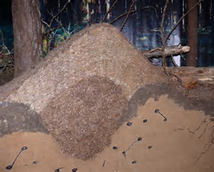
Freedom From Spiritual Parasites and Pest
Entities

Slide 23
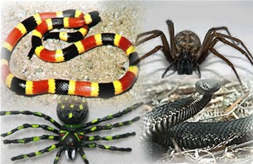
Spiders and snakes

Slide 24

30 minute break back at 12:30 Envision Grace and Ease Clear with Quantum Activation Techniques

